Slide 1


Nik Floden
May 15, 2022

Slide 2
Outline
Executive Summary
Introduction
Methodology
Results
Conclusion
Appendix

Slide 3
Executive Summary
The purpose of this project was to create a model to predict if a SpaceX Falcon 9 launch is successful in the recovery of its first stage. A successful recovery of the first stage of the Falcon 9 allows for the stage to be reused, which greatly reduces SpaceX's launch costs. Modeling the recovery outcome of the first stage helps determine the overall launch costs.
The data used to build these models came from two sources. The first source was the SpaceX REST API (https://github.com/r-spacex/SpaceX-API) and the second was scraped from the Wikipedia entry for the Falcon 9. Both sources included records such as the launch site, payload in Kg, outcome of launch, and more.
After sourcing and cleaning the data, several models were generated using unsupervised learning techniques. All models provided similar accuracy metrics, predicting a correct outcome on 83% of the test data.

Slide 4
Introduction
With the recent proliferation of commercial space programs, the cost of launch is a massive factor in their success or failure. SpaceX is particularly competitive in this regard because their Falcon 9 first stage is reusable. This allows SpaceX's minimum launch cost to be significantly lower than their competitors.
However, this reusability, and by extension lower cost, hinges on the successful recovery of the first stage. A competitor with the ability to predict if a given Falcon 9 launch would fail in recovery would have an advantage over SpaceX.

Slide 5

Section 1

Slide 6
Methodology
Executive Summary
Data collection methodology:
Data was collected using SpaceX API and scraped from Wikipedia
Perform data wrangling
Data was filtered and cleaned. Missing values imputed with means.
Perform exploratory data analysis (EDA) using visualization and SQL
Perform interactive visual analytics using Folium and Plotly Dash
Perform predictive analysis using classification models
4 unsupervised machine learning techniques were trained on the data.

Slide 7
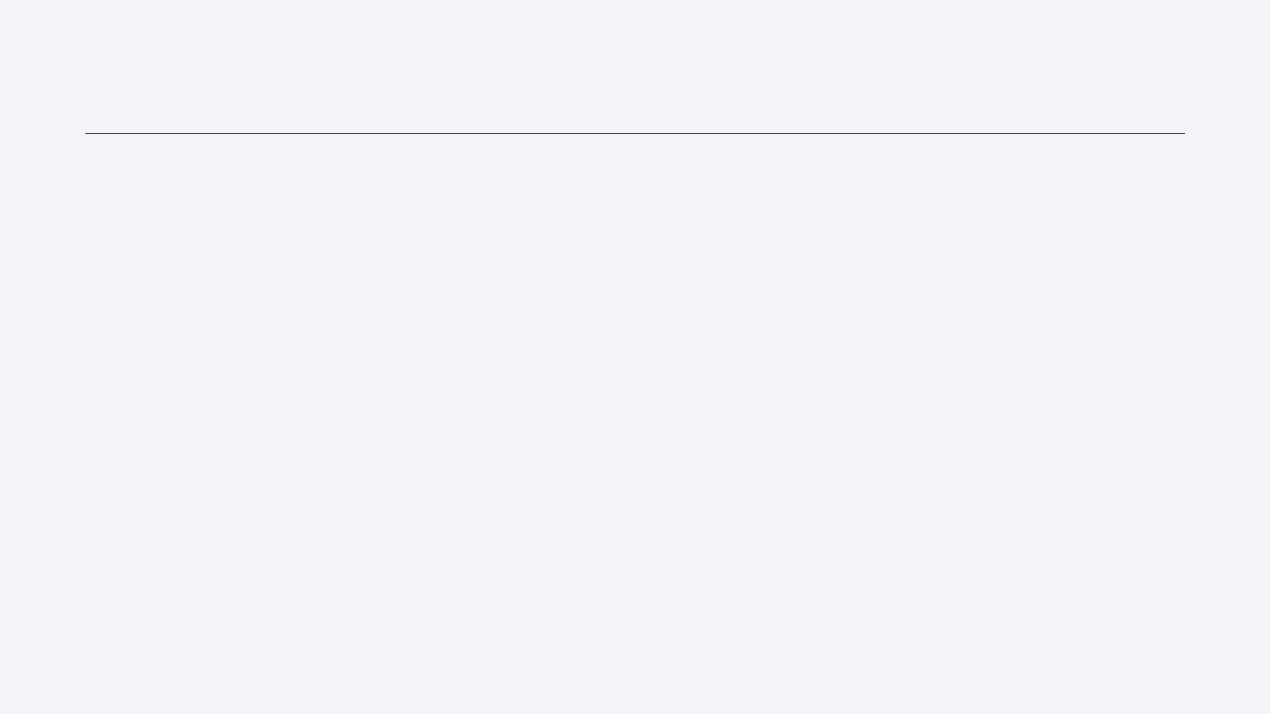
Data Collection – SpaceX API
We received the data through a GET request from the SpaceX REST API, then parsed through the resulting HTTP. After the HTTP was parsed and the info was extracted, the data was put into a DataFrame, then filtered and cleaned.
Access the notebook here
Import Libraries & Define Functions
Use the Requests library to use the SpaceX API
Parse through data, make it readable
Load data into DataFrame
Filter DataFrame to only Falcon 9 launches
Impute missing payload masses with mean value.

Slide 8
Data Collection - Scraping
We pulled the data from Wikipedia by using the Requests library, then parsed through the data using BeautifulSoup. After parsing, the data was added to a data frame.
Access the notebook here
Install BeautifulSoup & define the target page. Define Functions.
Perform a GET request on the page.
Add data to data frame.
Extract all column/variable names from the HTML table header
Create a data frame by parsing the launch HTML tables

Slide 9
Data Wrangling
The data was filtered to only include Falcon 9 launches (the data had prototype Falcon 1 launches).
Missing data was identified in the PayloadMass column. Missing data was replaced with the mean.
The Outcome column was encoded to a binary success/fail, and was normalized.
The Orbit column was encoded using one-hot encoding, befitting a categorical variable.
Click here for the corresponding notebook.

Slide 10
Flight Number and Launch Site – Visualized with a scatterplot to show relationship between launch site & # of launches.
Payload and Launch Site – Visualized with a scatterplot to show relationship between launch site & mass of payload.
Probability of Success and Orbit Type – Visualized with a bar chart, shows probability of success based on orbit type.
FlightNumber and Orbit type – Visualized with a scatterplot, shows relationship between the # of flights per orbit type.
Payload and Orbit type – Visualized with a scatterplot, shows mass of payload compared to orbit type.
Yearly success trend – Visualized with a line chart to show yearly recovery success rate.
Access the notebook here.
EDA with Data Visualization

Slide 11
EDA with SQL
Display the names of the unique launch sites in the space mission - SELECT DISTINCT(LAUNCH_SITE) FROM SPACEXTBL
Display 5 records where launch sites begin with the string 'CCA' - select * from spacextbl where launch_site like 'CCA%' limit 5
Display the total payload mass carried by boosters launched by NASA (CRS) - select sum(payload_mass__kg_) from spacextbl where customer = 'NASA (CRS)'
Display average payload mass carried by booster version F9 v1.1 - select avg(payload_mass__kg_) from spacextbl where booster_version like 'F9 v1.1%'
List the date when the first successful landing outcome in ground pad was achieved. - select min(date) from spacextbl where landing__outcome = 'Success (ground pad)'

Slide 12
EDA with SQL 2
List the names of the boosters which have success in drone ship and have payload mass greater than 4000 but less than 6000 - select distinct(booster_version) from spacextbl where landing__outcome = 'Success (drone ship)' and PAYLOAD_MASS__KG_ > 4000 and PAYLOAD_MASS__KG_ < 6000
List the total number of successful and failure mission outcomes - select count(*) from spacextbl where landing__outcome like 'Success%' or landing__outcome like 'Failure%'
List the names of the booster_versions which have carried the maximum payload mass. Use a subquery - select booster_version from spacextbl where PAYLOAD_MASS__KG_ = (select max(PAYLOAD_MASS__KG_) from spacextbl)
List the failed landing_outcomes in drone ship, their booster versions, and launch site names for in year 2015 - select landing__outcome, booster_version, LAUNCH_SITE, date from spacextbl where landing__outcome = 'Failure (drone ship)' and year(date)= 2015

Slide 13
EDA with SQL 3
Rank the count of landing outcomes (such as Failure (drone ship) or Success (ground pad)) between the date 2010-06-04 and 2017-03-20, in descending order - select landing__outcome, count(landing__outcome) from spacextbl where date between '2010-06-04' and '2017-03-20' group by landing__outcome order by count(landing__outcome) desc
Access the Notebook here.

Slide 14
Added markers to launch site coordinates to identify each launch site.
Added circles showing the number of launches at each site.
Added more markers showing failed and successful recovery attempts to show which launch sites have higher rates of recovery failure.
Added proximity lines between the launch site and nearby highways, coastlines, and railways to determine the ease of material delivery.
Access the notebook here.
Build an Interactive Map with Folium

Slide 15
Added pie charts to visualize the success rates of each launch site, as well as an overall view of all site success rates.
Added a scatterplot to show success rate vs mass of payload for each site, as well as for all sites.
Added a payload slider to show how payload mass ranges can be observed by site or overall.
Access the source code here.
Build a Dashboard with Plotly Dash

Slide 16
Predictive Analysis (Classification)
Normalize the data.
Tune hyperparameters and find the best score for each model.
Test predictions against test dataset.
Determine model accuracy.
Determine most accurate model.
Split data into training and testing datasets.
Fit the models to the training sets.
We ran these unsupervised ML methods:
Logistic Regression
Support Vector Machine
Decision Tree
K-nearest Neighbors
Access the notebook here.

Slide 17
Exploratory data analysis results
We found that the variables that most heavily effected the success rate were the payload mass, number of flights flown by the first stage, type of orbit, and (obviously) if the legs and grid fins were used.
Predictive analysis results
Each method had almost the exact same accuracy, except for the decision tree.
Results

Slide 18

Section 2

Slide 19
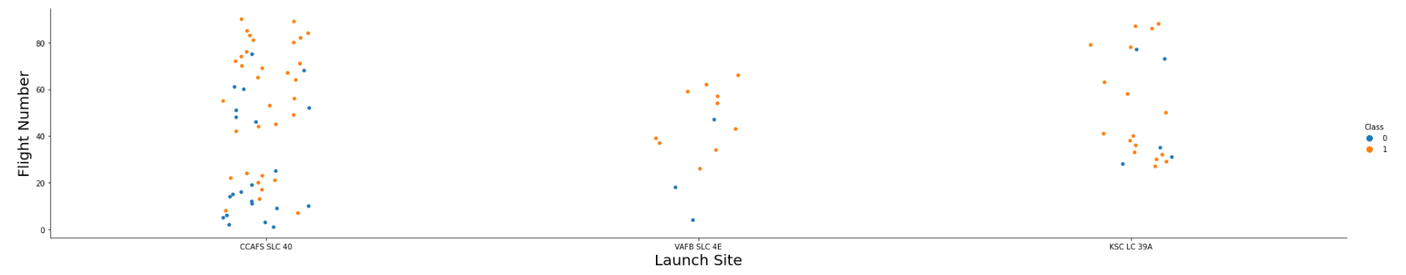
Flight Number vs. Launch Site
The plot shows that the least-used launch site is VAFB SLC-4E and CCAFS SLC-40 has been used the most.
It also appears that as the number of flights increases, the number of failures decreases.
CCAFS SCL 40 also seems to have more failures, even relative to the other two.

Slide 20
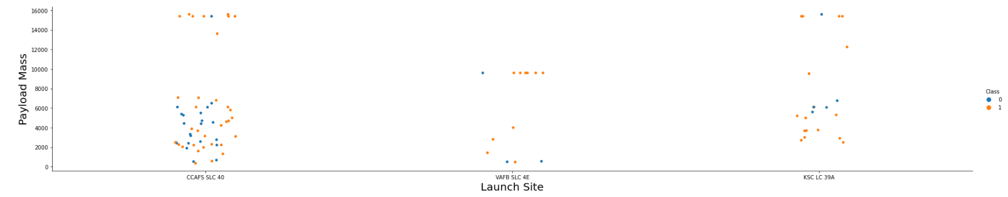
From this scatter plot, there appears to be a relationship where the lower the payload mass, a successful recovery is less likely.
This also shows that VAFB has the lowest max payload.
Payload vs. Launch Site

Slide 21
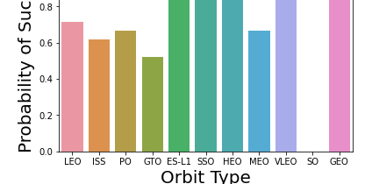
Success Rate vs. Orbit Type
It appears that there has only been success for the L1, SSO, HEO, and GEO orbits.
Inversely, SO orbit appears to have no successes.

Slide 22
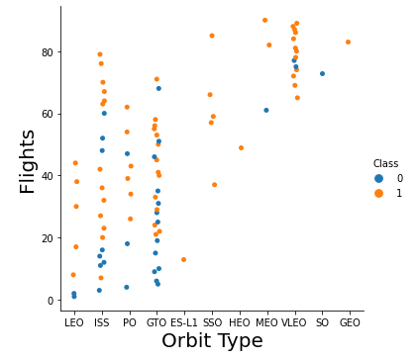
Flight Number vs. Orbit Type
It appears that the majority of flights are for the ISS and GTO orbits.
SO orbit has only one flight, and one failure.
The majority of the most recent flights are into VLEO.

Slide 23
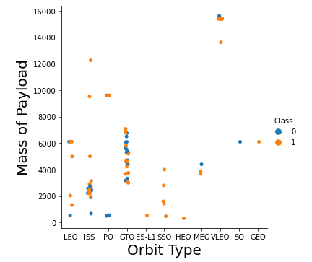
Payload vs. Orbit Type
VLEO has the highest mass payloads.
The lowest mass payloads appear to have a small cluster of failures.
Majority of failures are for the ISS w/ average payload mass, and GTO for any payload mass.

Slide 24
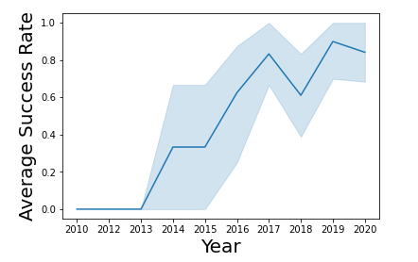
Launch Success Yearly Trend
The average success rate has been overall increasing.
There was a sharp decline in success rate in 2018.
Peak success was in 2019.

Slide 25
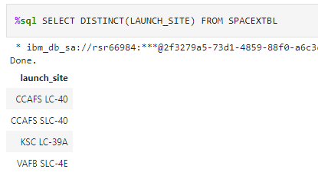
All Launch Site Names
CCAFS LC-40
CCAFS SLC-40
KSC LC-39A
VAFB SLC-4E

Slide 26
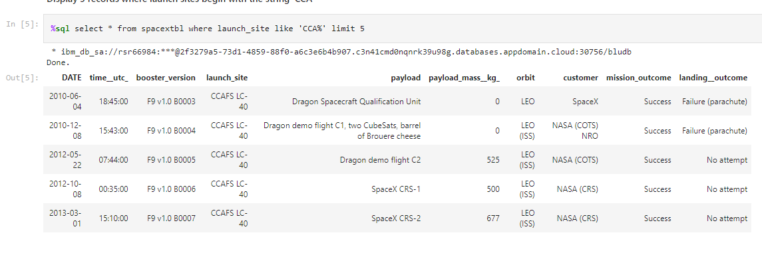
Launch Site Names Begin with 'CCA'
As can be seen, the first launch at a 'CCA' site was in 2010 by SpaceX.

Slide 27
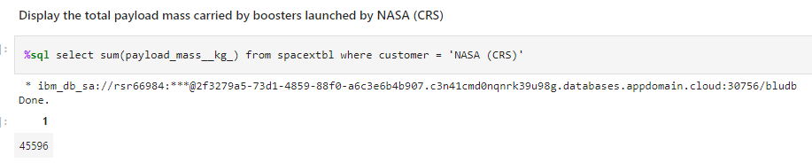
Total Payload Mass
The total payload mass launched for NASA was 45596kg

Slide 28
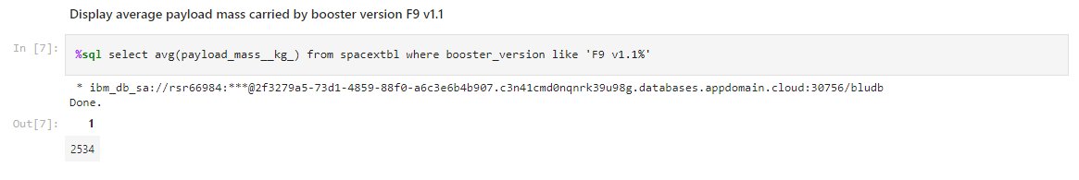
Average Payload Mass by F9 v1.1
Average payload on the F9 v1.1 booster was 2534kg.

Slide 29
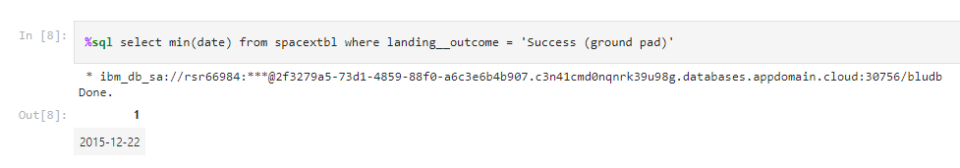
First Successful Ground Landing Date
The first successful ground landing date was Dec 22, 2015

Slide 30
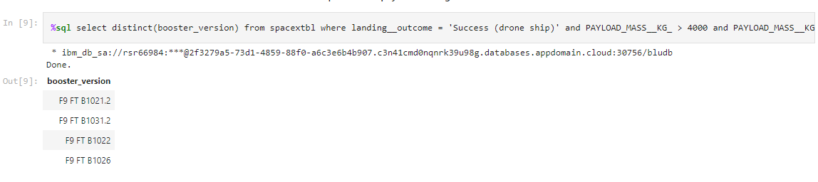
Successful Drone Ship Landing with Payload between 4000 and 6000
These are the boosters that have had successful landings on drone ships.

Slide 31
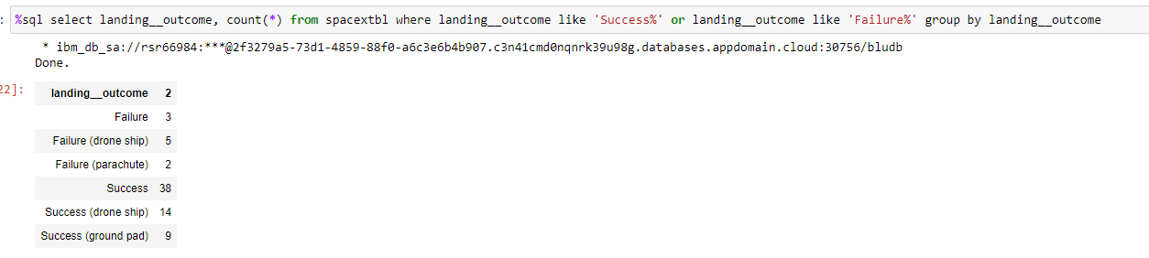
Total Number of Successful and Failure Mission Outcomes

Slide 32
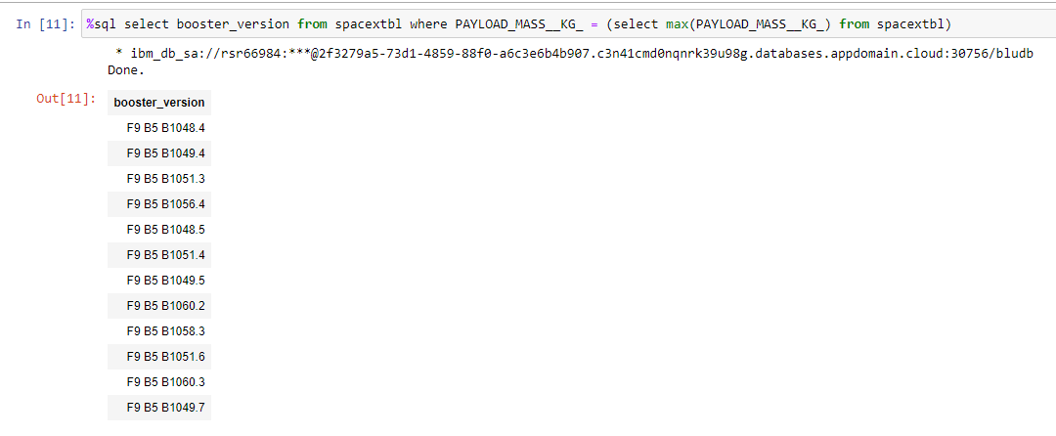
Boosters Carried Maximum Payload
List the names of the booster which have carried the maximum payload mass
Present your query result with a short explanation here

Slide 33
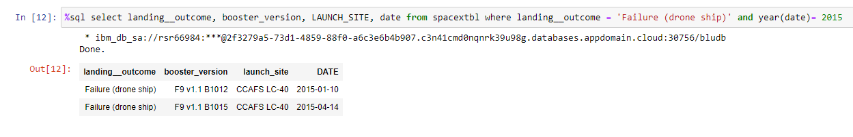
2015 Launch Records
There were two failures from the drone ship, both were launched from CCAFS LC-40.

Slide 34
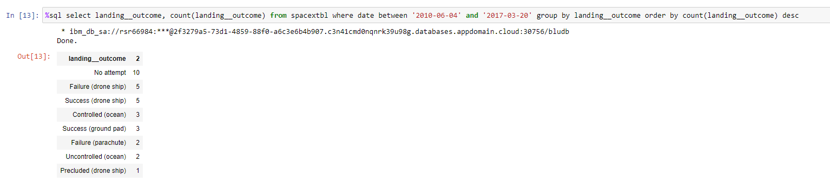
Rank Landing Outcomes Between 2010-06-04 and 2017-03-20
Rank the count of landing outcomes (such as Failure (drone ship) or Success (ground pad)) between the date 2010-06-04 and 2017-03-20, in descending order
Present your query result with a short explanation here

Slide 35

Section 3

Slide 36

Locations of Launch Sites
This shows all the locations of the launch sites. All of them appear to be on the coast of the United States.

Slide 37

Launch Markers w/ Success Rate
This shows the number of launch attempts at the site. Then each marker shows red for a fail, and green for a success.

Slide 38

Proximity Lines
This shows the CCAFS SLC-40 launch site's proximity to the coastline, which is important in the case of an aborted launch.

Slide 39

Section 4

Slide 40
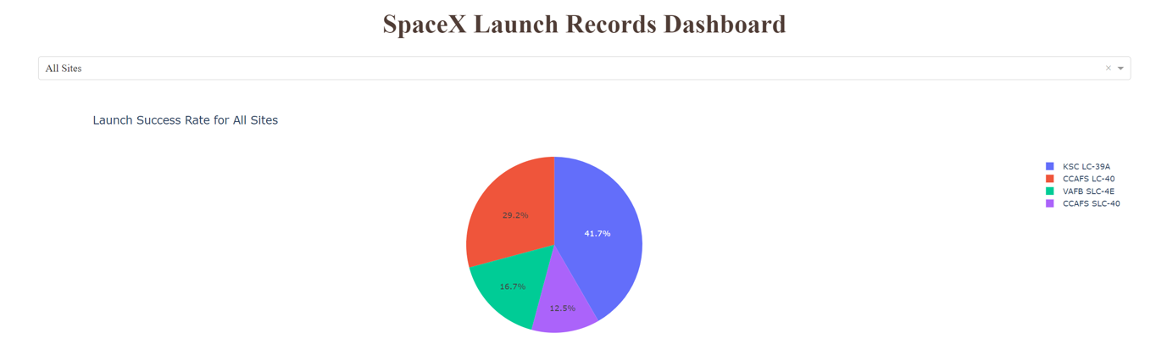
The KSC LC-39A launch pad has the most success for all sites.
The CCAFS SLC-40 launch site has the lowest amount of successes.
Success rates for All Sites

Slide 41
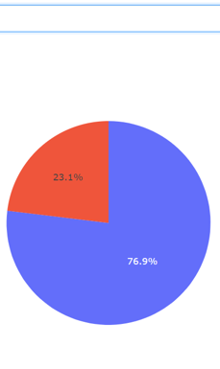
Launch success ratio for KSC LC-39A
The KSC LC-39A site has the highest success rate of all the launch sites, with a whopping 76.9% success rate.

Slide 42
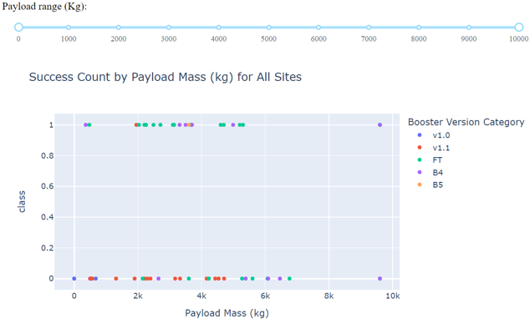
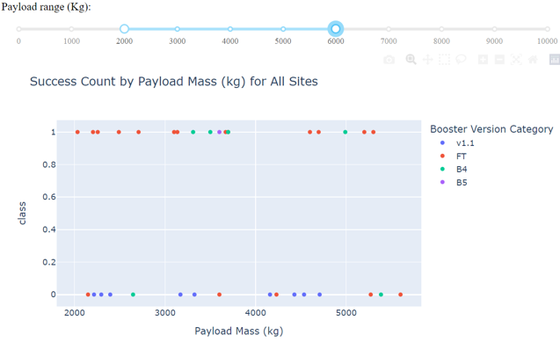
Success Rate by Payload Mass for all sites
The FT Booster appears to have the highest rate of success according to the left plot.
The range between 2000kg and 6000kg appears to be the most successful for the FT booster.

Slide 43

Section 5

Slide 44
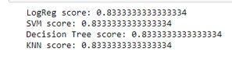
Classification Accuracy
As can be seen, all four of the classifiers have the same score.

Slide 45
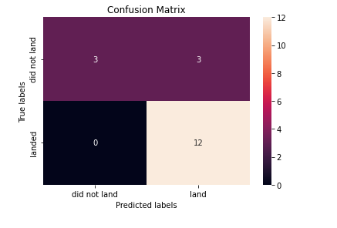
Confusion Matrix
Since all the confusion matrixes are the same, the fact that this is the SVM's confusion matrix is moot.
The classifiers all appear to have problems with predicting false positives.

Slide 46
Conclusions
Flight number appears to have a high correlation to success, the more launches sent up, the more likely success is.
Payload appears to have an effect as well, seeing as almost every payload at max was a success.
Data based on what the payload was may shed more light on if the boosters are re-used. (Remember that SpaceX sometimes can choose to not re-use boosters)
SLC-40 has the lowest overall success rate.
It appears no matter the classifier used, Falcon 9 recovery rate can be estimated by machine learning with a high degree of accuracy.

Slide 47


